Slide 1


IN AND OUTS OF Web components

Slide 2
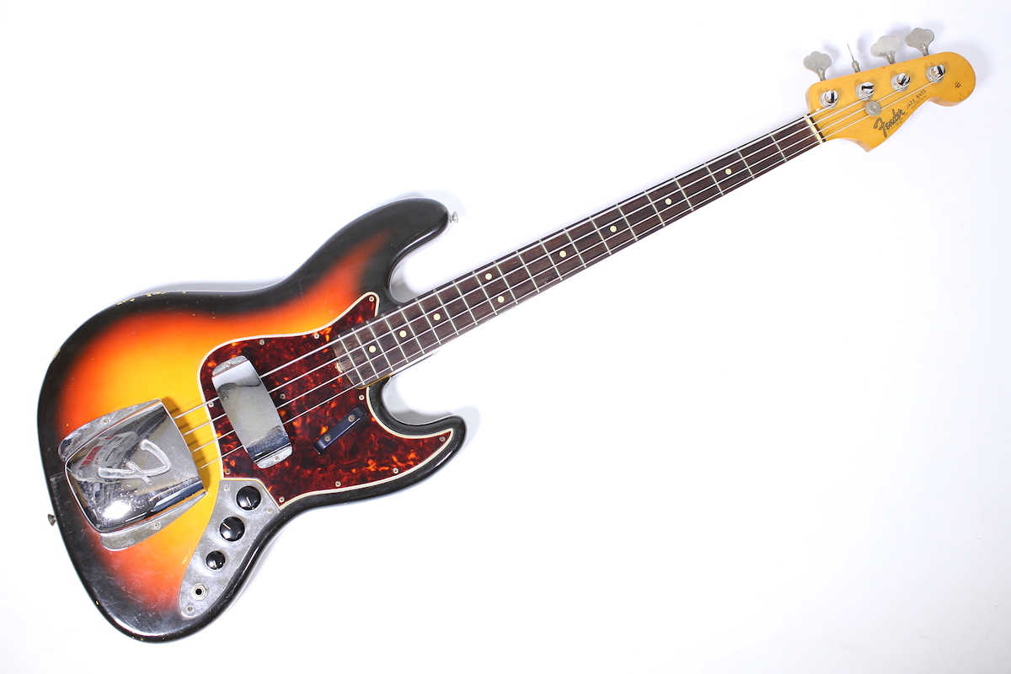


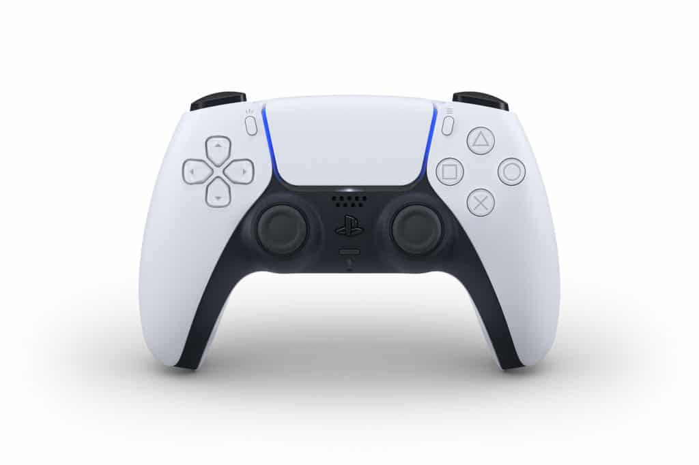
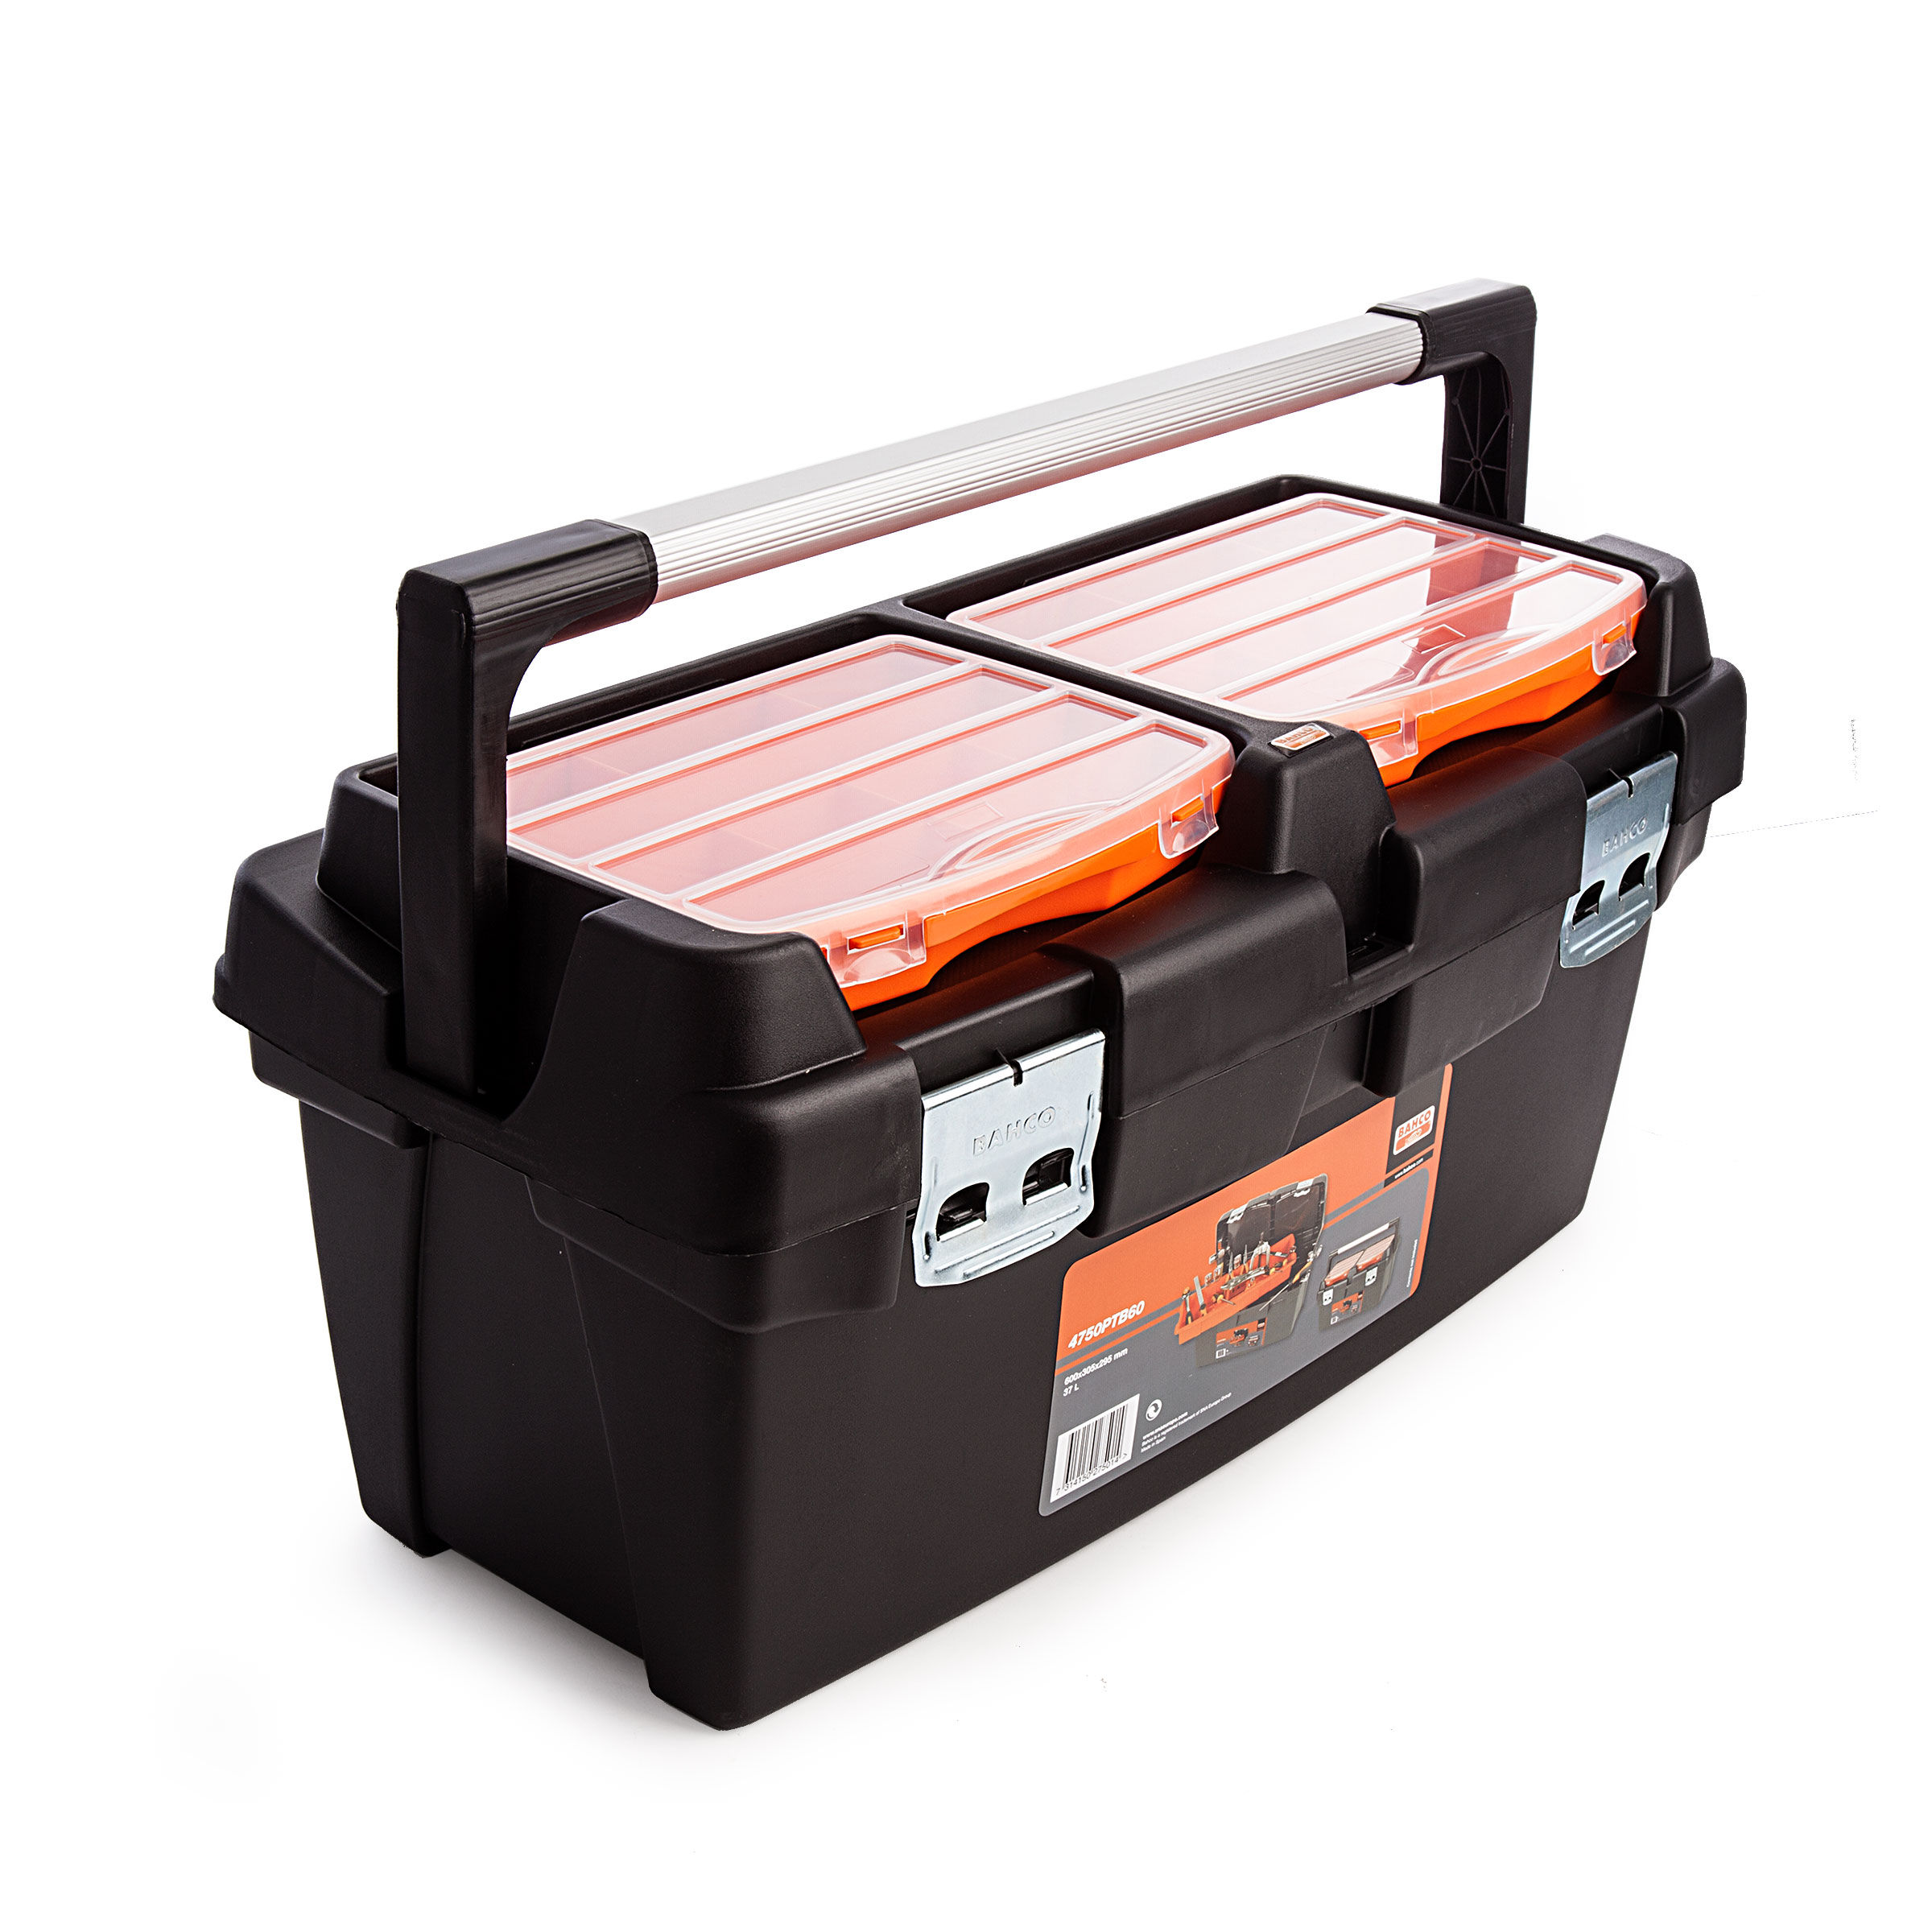
Hello!
I am Maarten Dekker
maarten.dekker@capgemini.com
www.linkedin.com/in/maartendek/
github.com/maartendek

Slide 3
AGENDA
1. Using Frameworks to create Web Components
LIT
Stenciljs
2. Implementing Web Components
HTML & Javascript
Angular
React

Slide 4
Shared files
Github
https://github.com/thordijk/bld-webcomponents
https://github.com/maartendek/bld-webcomponents
NPM package
https://www.npmjs.com/package/bld-wc-stencil

Slide 5
WEB COMPONENT FRAMEWORKS
4

Slide 6
LitElements Stenciljs

Slide 7
LitElements
$ npm init @open-wc
lit.dev
npmjs.com/package/lit
open-wc.org/

Slide 8
code

Slide 9
stenciljs
$ npm init stencil
> https://stenciljs.com

Slide 10
code

Slide 11
Implementing WEB COMPONENTS
5

Slide 12
Basic html & js react angular

Slide 13
Basic html & js
<script src=“/my-awesome-counter.js” />
window.customElements.define(
‘my-awesome-counter’, MyAwesomeCounter
);
<my-awesome-counter count=“1”>
</my-awesome-counter>
Load Javascript, CSS
Make component accessible in HTML

Slide 14
Stenciljs
<script type="module" src="/build/bld-wc-stencil.esm.js" data-stencil></script>
<script nomodule src="/build/bld-wc-stencil.js" data-stencil></script>
Load Javascript, CSS
Make component accessible in HTML
One or more components in a package

Slide 15
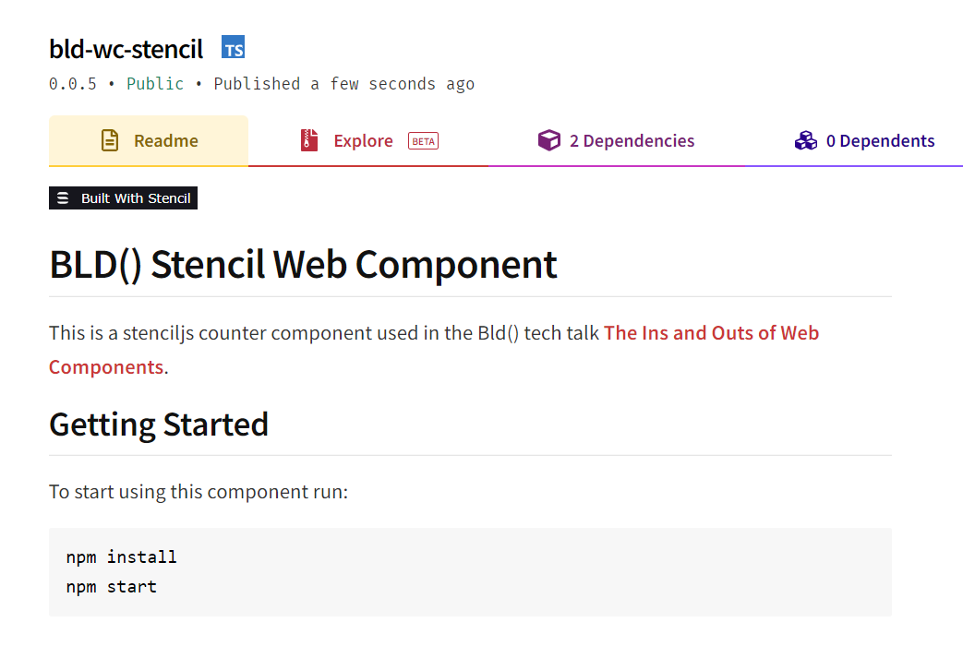
Wait? Package?
npmjs.com/package/bld-wc-stencil

Slide 16
react
$ npx create-react-app bld-app-react
$ npm i bld-wc-stencil

Slide 17
react
import { applyPolyfills, defineCustomElements }
from 'bld-wc-stencil/loader’
applyPolyfills().then( () => {
defineCustomElements(window);
});

Slide 18
code

Slide 19
angular
$ ng new bld-app-angular
$ npm i bld-wc-stencil

Slide 20
angular
import { CUSTOM_ELEMENTS_SCHEMA } from '@angular/core';
import { defineCustomElements } from 'bld-wc-stencil/loader’;
defineCustomElements(window);

Slide 21
code

Slide 22

Thank you
Github
https://github.com/thordijk/bld-webcomponents
https://github.com/maartendek/bld-webcomponents
NPM package
https://www.npmjs.com/package/bld-wc-stencil
capgemini.com

